Slide 1



CN-Celeb: multi-genre
speaker recognition
Lantian Li
Center for Speech and Language Technologies, Tsinghua University
lilt@mail.tsinghua.edu.cn
2020.11.15

Slide 2
Evolution of speaker recognition
Challenge, Techniques, Corpora
Phase 1 (1960~1990)
Challenge : Randomness in pronunciation
Technique : DTW, HMM
Corpora : Text-dependent private data
Phase 2 (1995~2010)
Challenge : Phonetic variation
Technique : GMM, GMM-UBM
Corpora : Switchboard, NIST SRE (-03)
Phase 3 (2005~2016)
Challenge : Session variation
Technique : JFA, i-vector/PLDA
Corpora : Mixer, NIST SRE (04-16)
Phase 4 (2017~ )
Challenge : Complex variation
Technique : Deep learning
Corpora : VoxCeleb, NIST SRE (18-19)
Notes:
对目标任务的认知，抽象出不同的研究挑战；
面对挑战选择何种技术；
如何设计数据，验证技术有效性

Slide 3
What is the next phase ?
Challenge
Speaking in the wild under complex multi-genre conditions.
For instance, one enrolls with reading speech while tests with singing.
Technique
Deep learning methods, or others.
Corpora
We need a real multi-genre corpus, which covers intrinsic (speaking style, physiological status) and extrinsic (recording device, background noise) inter-session variations !
Notes:
内在和外在的不同会话的扰动、随机性，构建一个真正意义上的多场景数据集，用于研究复杂场景下的说话人识别技术。

Slide 4
CN-Celeb: a large-scale multi-genre corpus
Collection pipeline
Data profile
Multi-genre challenge
Multi-genre training

Slide 5
CN-Celeb: a large-scale multi-genre corpus
Collection pipeline
Data profile
Multi-genre challenge
Multi-genre training

Slide 6
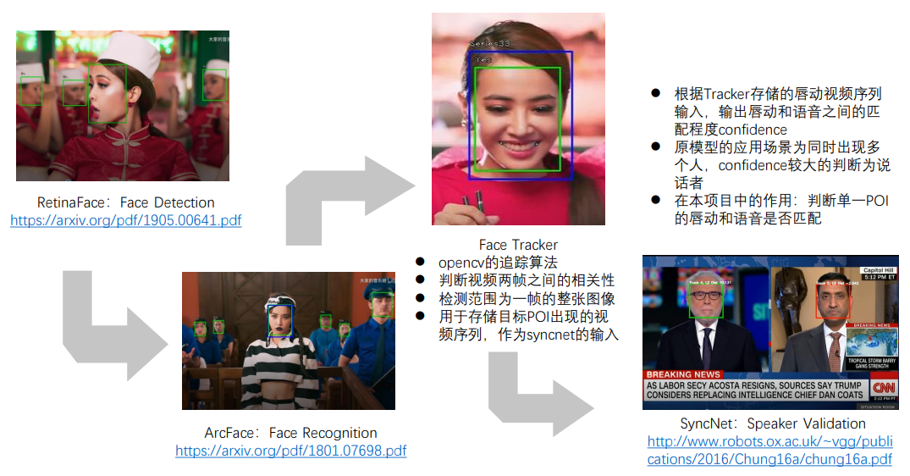
Collection pipeline
STEP 1: POI list design
STEP 2: Pictures and videos download
STEP 3: Face detection and tracking
STEP 4: Active speaker verification
STEP 5: Double check by speaker recognition
STEP 6: Human check
Toolkit: http://cslt.riit.tsinghua.edu.cn/mediawiki/index.php/CN-Celeb
Notes:
1、名人列表；2、下载图片和视频；3、人脸检测与追踪；4、口唇一致性检测；5、声纹识别二次确认；6、人工核查

Slide 7
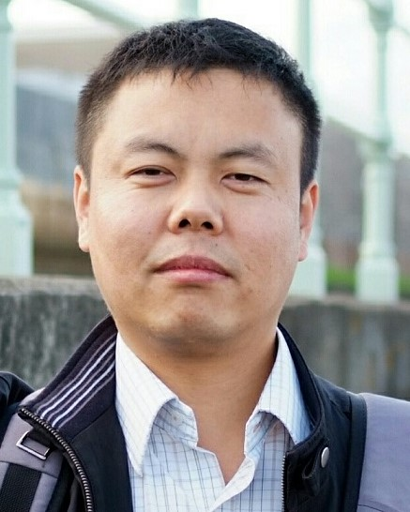
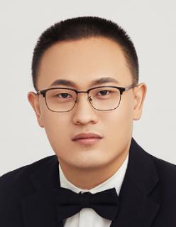
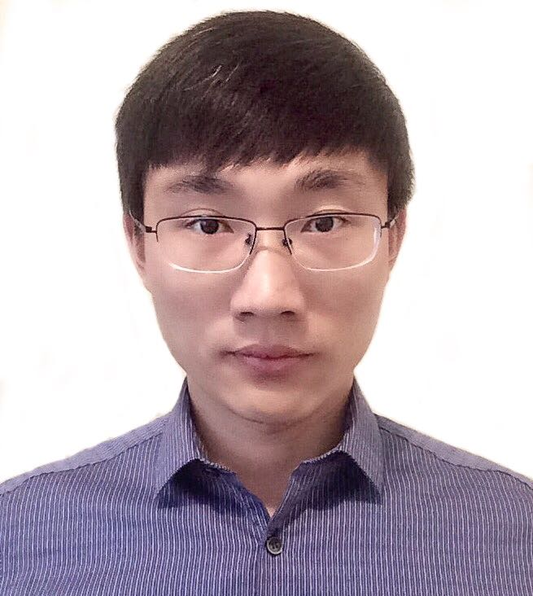
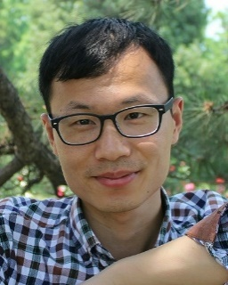
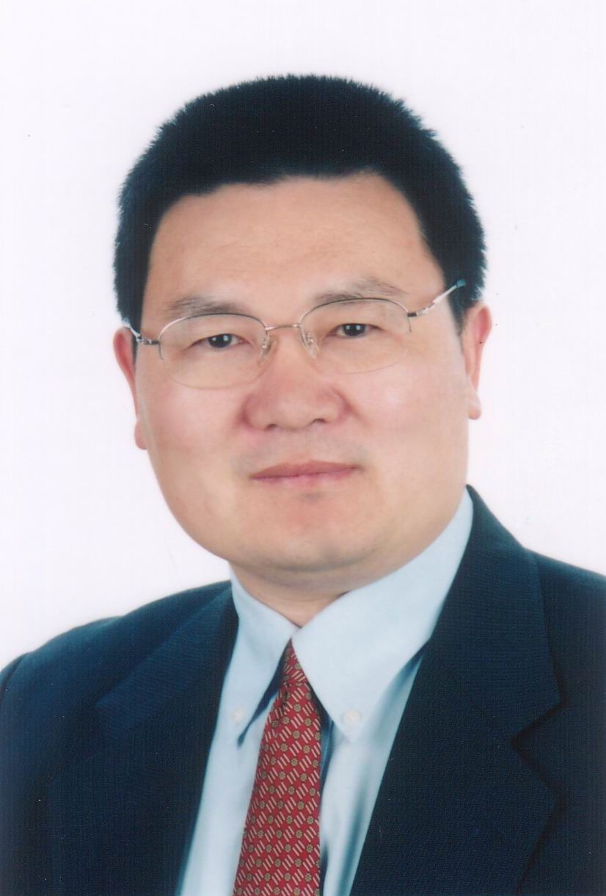
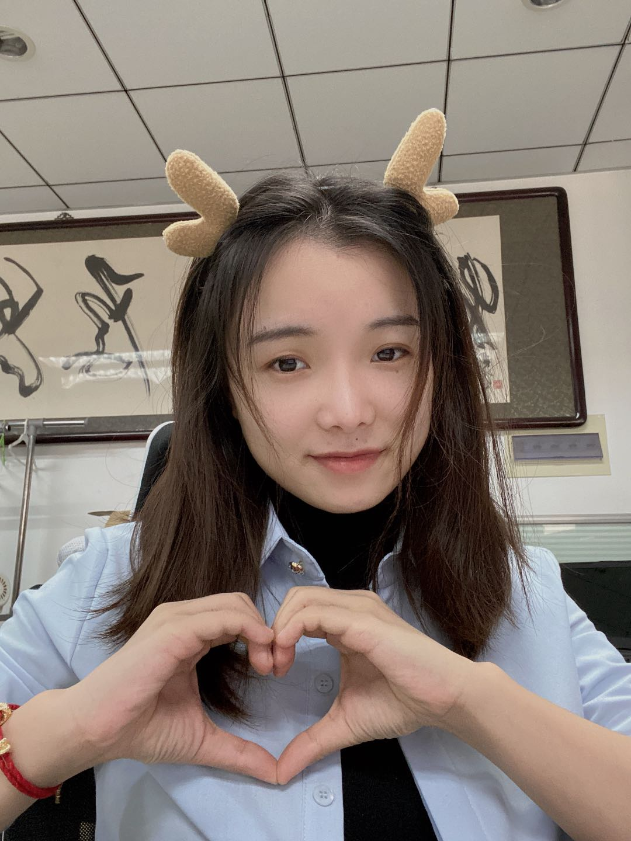
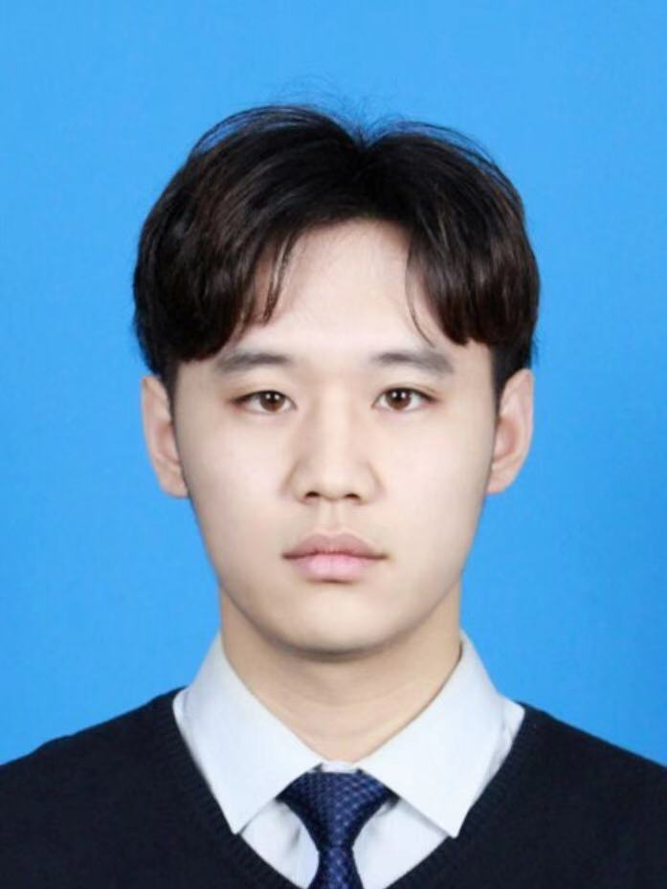
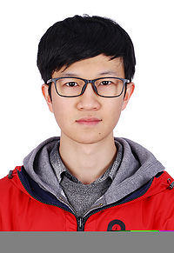
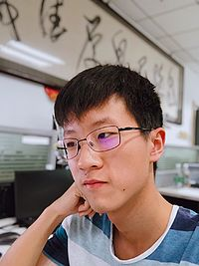
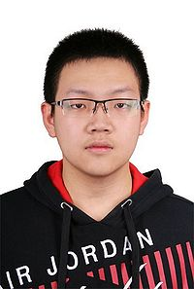

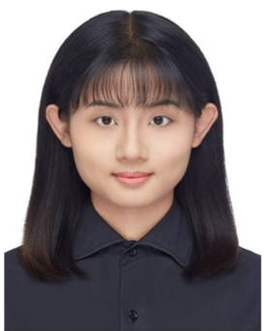
Contributors of CN-Celeb
Dong Wang
Lantian Li
Yunqi Cai
Zhiyuan Tang
Fang Zheng
Yue Fan
Jiawen Kang
Kaicheng Li
Haolin Chen
Sitong Cheng
Pengyuan Zhang
Ziya Zhou

Slide 8
CN-Celeb: a large-scale multi-genre corpus
Collection pipeline
Data profile
Multi-genre challenge
Multi-genre training

Slide 9
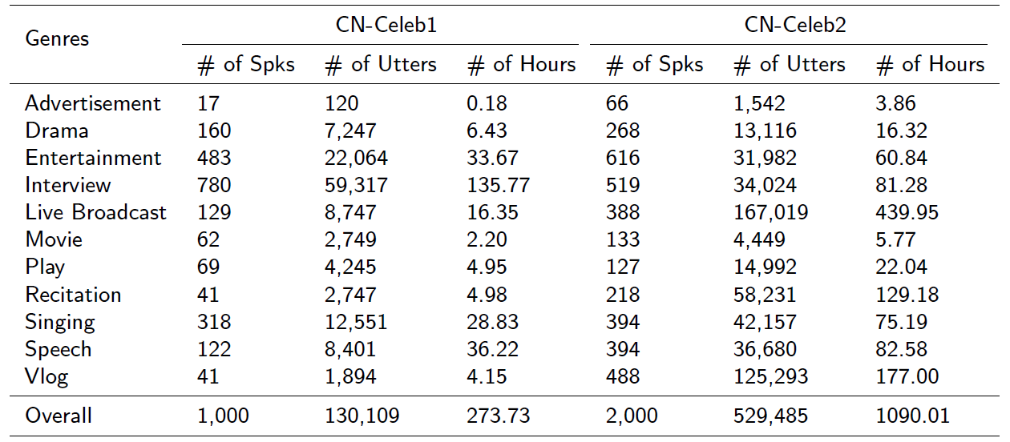
Overall data profile
11 genres
Download: http://www.openslr.org/82/
Notes:
广告、戏剧、娱乐、采访、广播、电影、表演、朗读、唱歌、演讲、微视频
总共 3000人，1360+ 小时

Slide 10
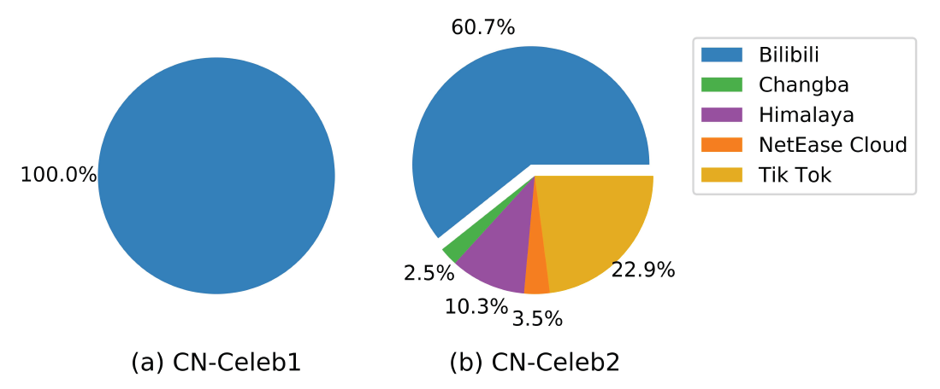
Media source
Multi-media sources
Download: http://www.openslr.org/82/
Notes:
B站、唱吧、喜马拉雅、网易云、抖音

Slide 11
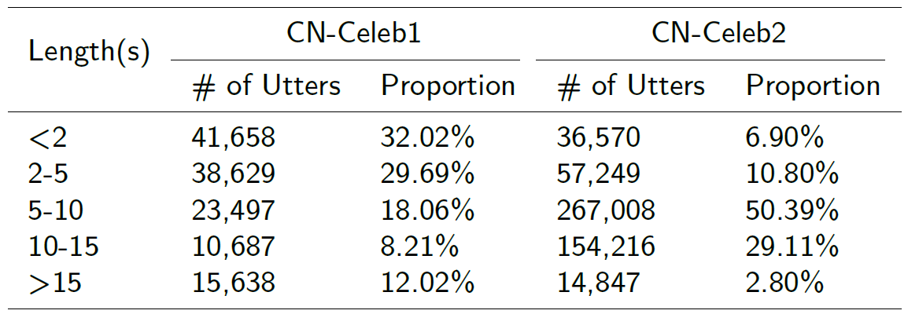
Speech duration
Short-utterance challenge
Download: http://www.openslr.org/82/
Notes:
10秒以内的短语音占有很大比重，形成了天然的短语音问题！

Slide 12
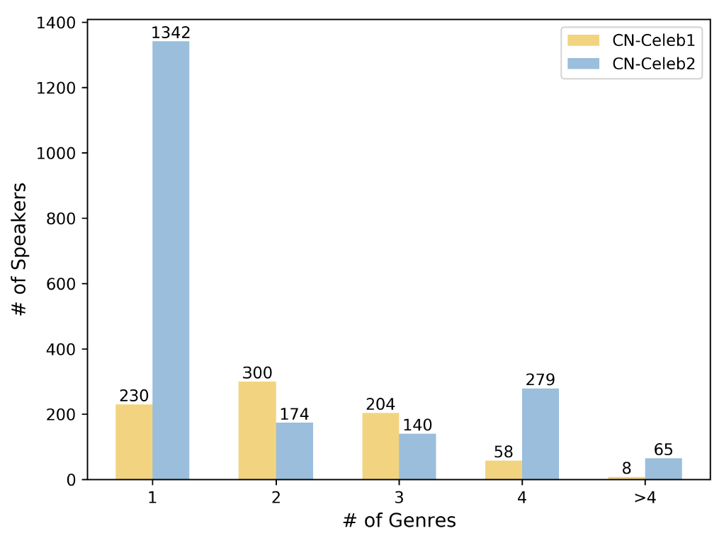
Speaker genres
60% multi-genre speakers in CN-Celeb1 (570)
30% multi-genre speakers in CN-Celeb2 (658)
Download: http://www.openslr.org/82/

Slide 13
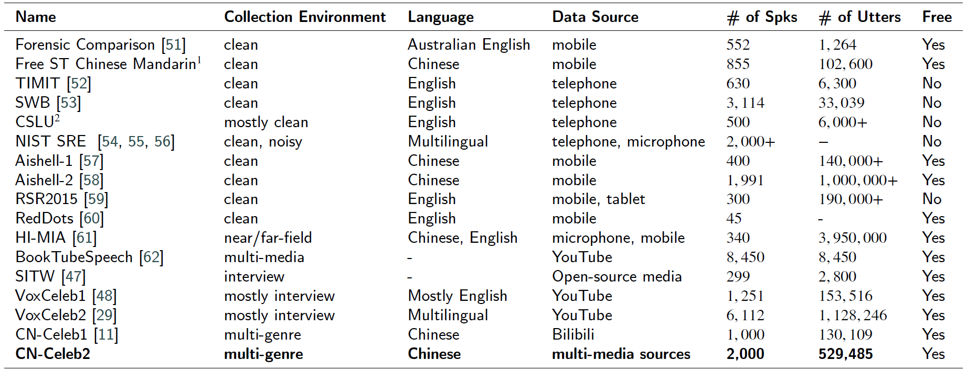
Comparison of existing datasets
Notes:
覆盖更多真实场景，真正的 speaking in the wild !
当前总数据量达到 3000 人，1300 多小时。数据量基本足以支撑搭建一个声纹识别系统的要求。

Slide 14
CN-Celeb: a large-scale multi-genre corpus
Collection pipeline
Data profile
Multi-genre challenge
Multi-genre training

Slide 15
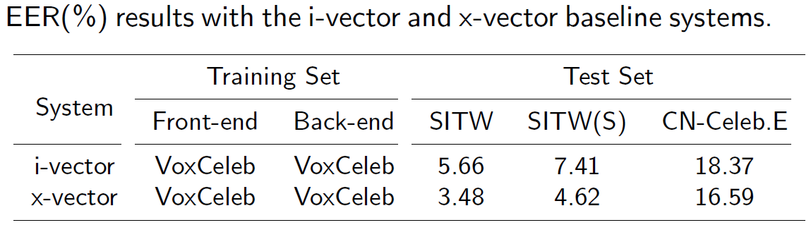
Basic results
The performance of the current speaker recognition techniques might be much worse than it was thought.
Kaldi recipe: https://github.com/kaldi-asr/kaldi/tree/master/egs/cnceleb
Notes:
当前说话人识别系统性能可能远没有我们想象中那么理想！

Slide 16
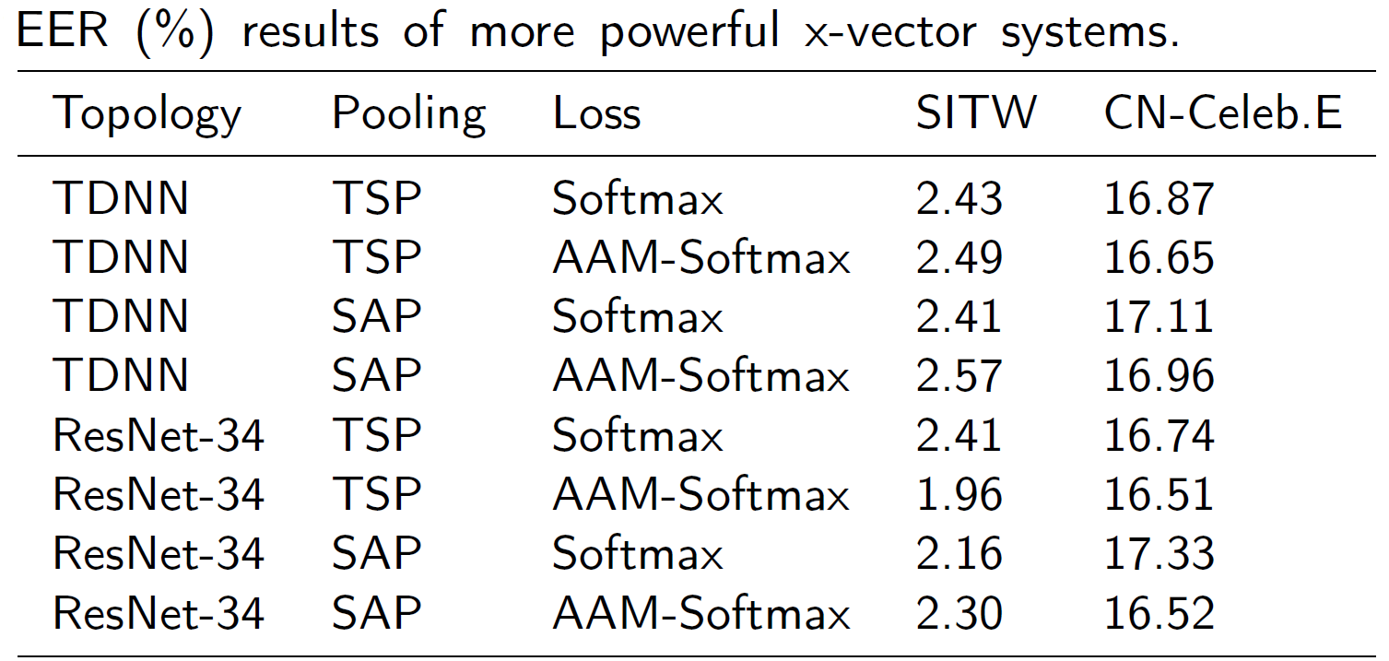
SOTA systems
The SOTA techniques are of little help in solving multi-genre challenge !
Source code: https://github.com/mycrazycracy/tf-kaldi-speaker
Notes:
单一场景、集内场景可以得到很好地性能表现；但是在复杂场景、集外场景上几乎失效！

Slide 17
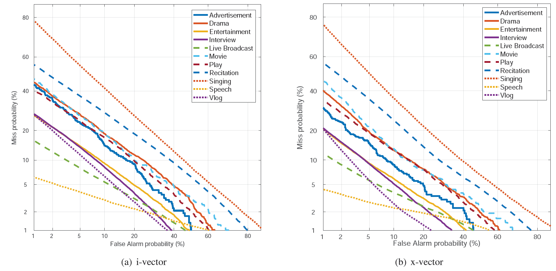
Within-genre results
DET curves of different genres
Notes:
具体地，我们发现不同场景有着不同的性能表现。并且性能趋势与我们直观的感觉基本一致。
对于演讲、广播、采访等场景，其内在和外在干扰较少，性能稳定较优；
反之，对于唱歌、电影等场景，其通常存在各种扰动，性能表现难以令人满意。

Slide 18
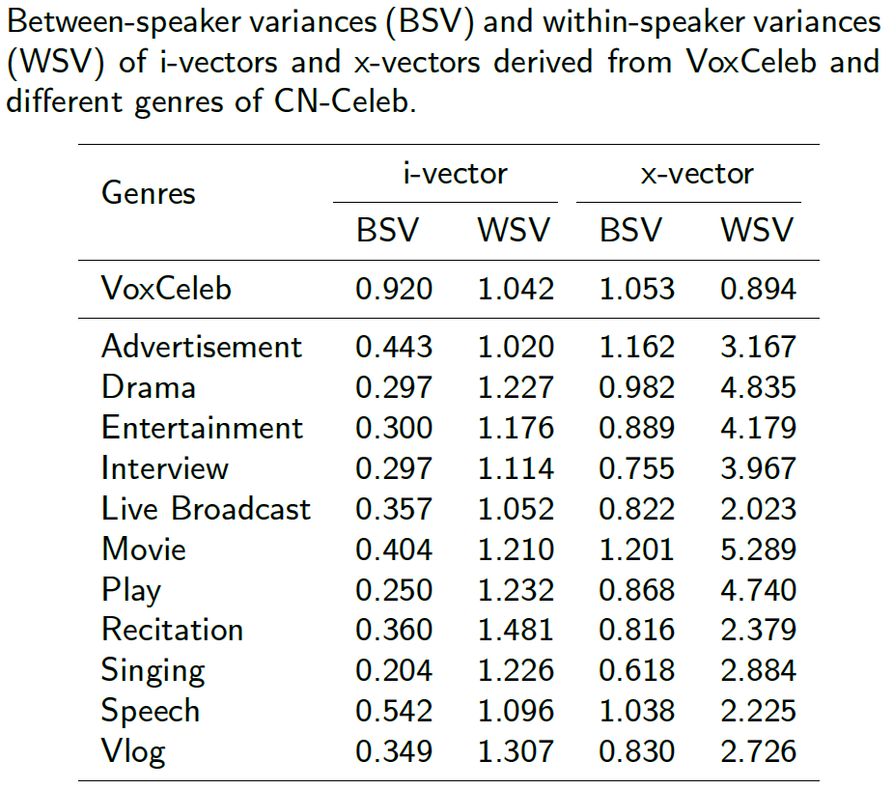
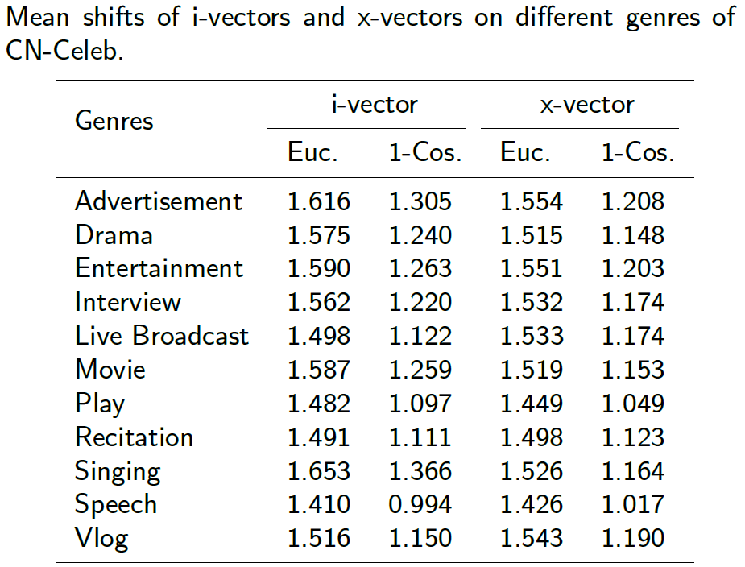
Statistical analysis
Notes:
为了解释这一现象，我们对不同场景数据进行统计量分析，分析结果表明。。。

Slide 19
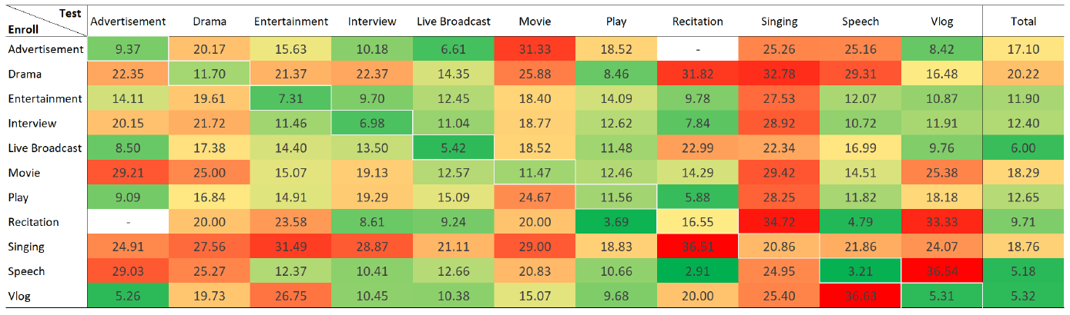
Cross-genre results
EER results with the x-vector system
Heat map (Green -> Red) corresponds to EER value (Low -> High)

Slide 20
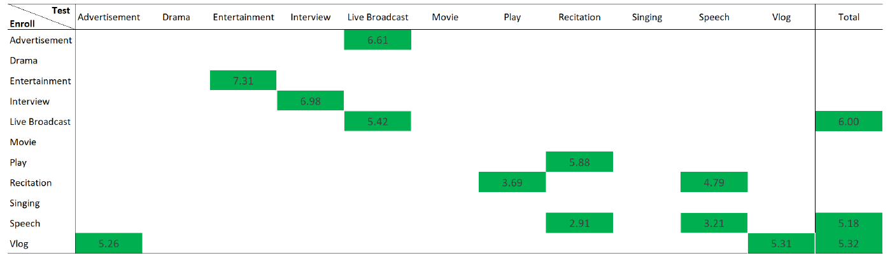
Cross-genre results
Acceptable conditions with EER threshold 7.43%
Only few conditions can be deemed acceptable !
Notes:
为了更清晰的展示当前说话人识别系统到底在哪些场景可用，哪些场景不可用。我们以等错误率 7.43 为分水岭，对结果进行了划分。
低于保留，高于去掉。发现，当前说话人识别系统真正可用的场景仅占据了很小了的一部分。
由此可见，多场景说话人识别是一个极具挑战性的研究方向。

Slide 21
CN-Celeb: a large-scale multi-genre corpus
Collection pipeline
Data profile
Multi-genre challenge
Multi-genre training
Notes:
为此，我们开展了一些相对基础的探索

Slide 22
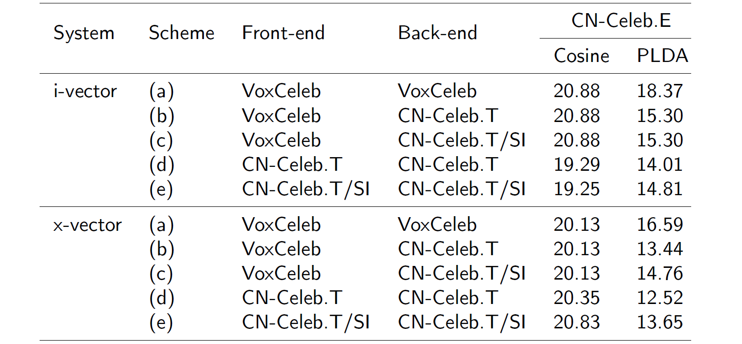
Front-end and back-end training
Single-genre, multi-genre and partial multi-genre training
Multi-genre data is important for training and test.
Notes:
我们研究发现，MG data 很重要！

Slide 23
This is the next phase !
How to employ the multi-genre data more effectively ?
How to deal with these extremely difficult genres ?
How to implement genre transfer or adaptation ?
How to deal with genre generalization issue ?
……
Notes:
总而言之，多场景测试对当前系统来说十分困难，我们认为这是说话人识别下一个研究阶段的重要方向。
未来需要解决的难题有很多很多，例如。。。

Slide 24
Join us !
Let us study these interesting topics together.
Center for speech and language technologies (CSLT), BNRist at Tsinghua University, Beijing.
Postdoc fellow, Research engineer, Research intern
Contact me: lilt@mail.tsinghua.edu.cn
Notes:
对我们研究方向感兴趣的小伙伴可以与我联系

Slide 25
Summary
CN-Celeb : a large-scale multi-genre speaker recognition corpus.
Multi-genre speaker recognition can be regarded as the next research phase.
Toolkit : http://cslt.riit.tsinghua.edu.cn/mediawiki/index.php/CN-Celeb
Paper : https://arxiv.org/abs/1911.01799
Download : http://www.openslr.org/82/
Kaldi recipe : https://github.com/kaldi-asr/kaldi/tree/master/egs/cnceleb

Slide 26
Thank you !
http://lilt.cslt.org/
http://cslt.riit.tsinghua.edu.cn/

